Slide 1
Mathematical Economics
Lecture 5

Slide 2
Plan
Supremum Property
Properties of real functions
Extreme Value Theorem
Intermediate Value Theorem
Monotone functions

Slide 3
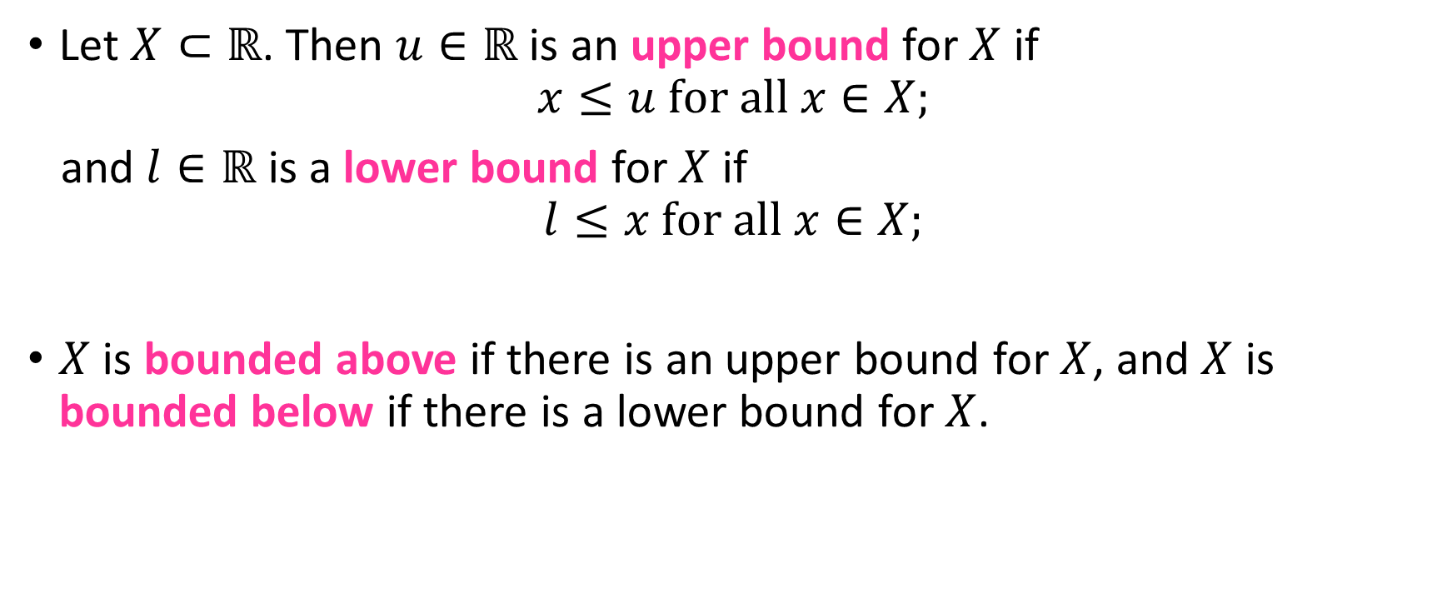
Upper & Lower Bounds
Let $X⊂ℝ$. Then $u∈ℝ$ is an upper bound for $X$ if
$$x≤u for all x∈X;$$
and $l∈ℝ$ is a lower bound for $X$ if
$$l≤x for all x∈X;$$
$X$ is bounded above if there is an upper bound for $X$, and $X$ is bounded below if there is a lower bound for $X$.

Slide 4
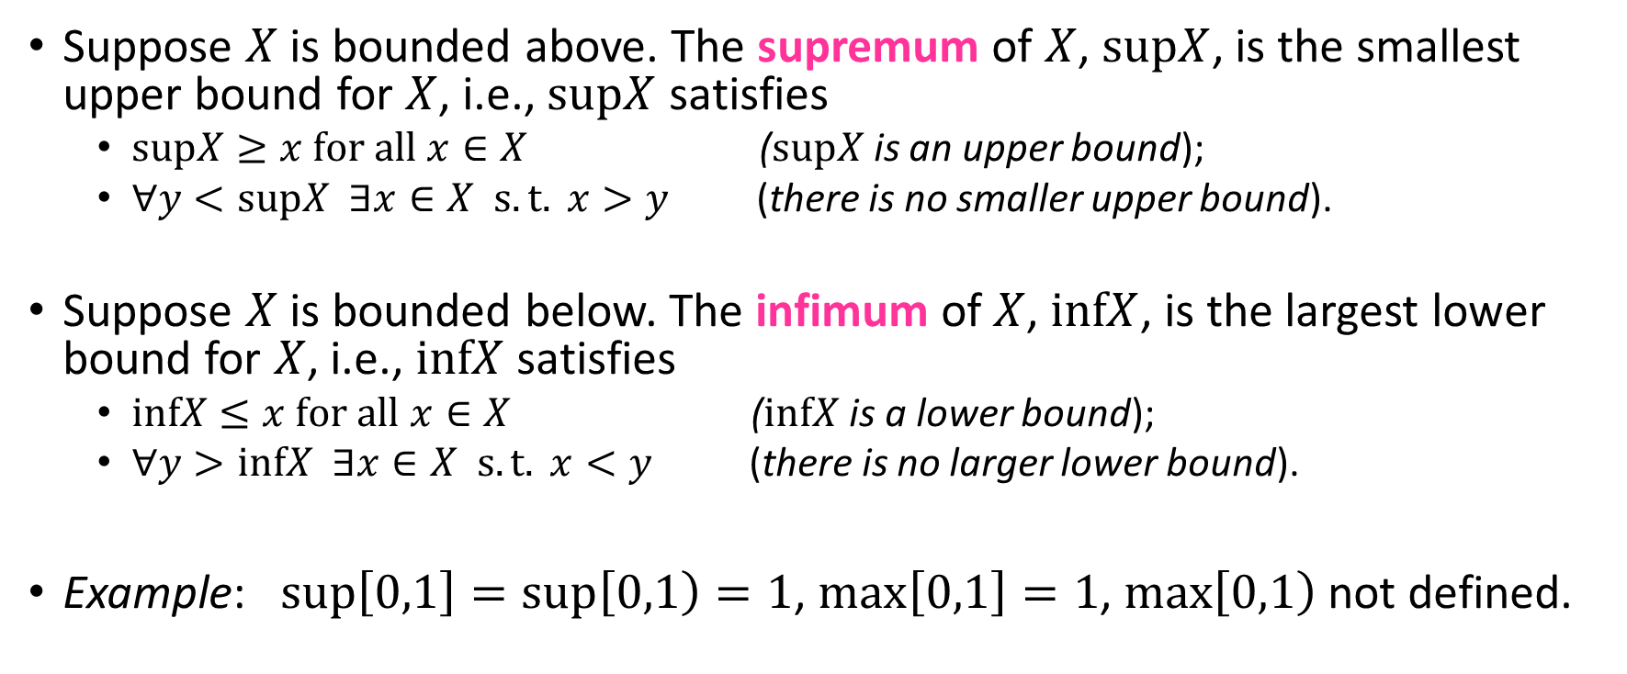
Supremum & Infimum
Suppose $X$ is bounded above. The supremum of $X$, $supX$, is the smallest upper bound for $X$, i.e., $supX$ satisfies
$supX≥x for all x∈X$ ($supX$ is an upper bound);
$∀y<supX ∃x∈X s.t. x>y$ (there is no smaller upper bound).
Suppose $X$ is bounded below. The infimum of $X$, $infX$, is the largest lower bound for $X$, i.e., $infX$ satisfies
$infX≤x for all x∈X$ ($infX$ is a lower bound);
$∀y>infX ∃x∈X s.t. x<y$ (there is no larger lower bound).
Example: $sup\left[0,1\right]=sup\left[0,1\right)=1$, $max\left[0,1\right]=1$, $max\left[0,1\right)$ not defined.

Slide 5
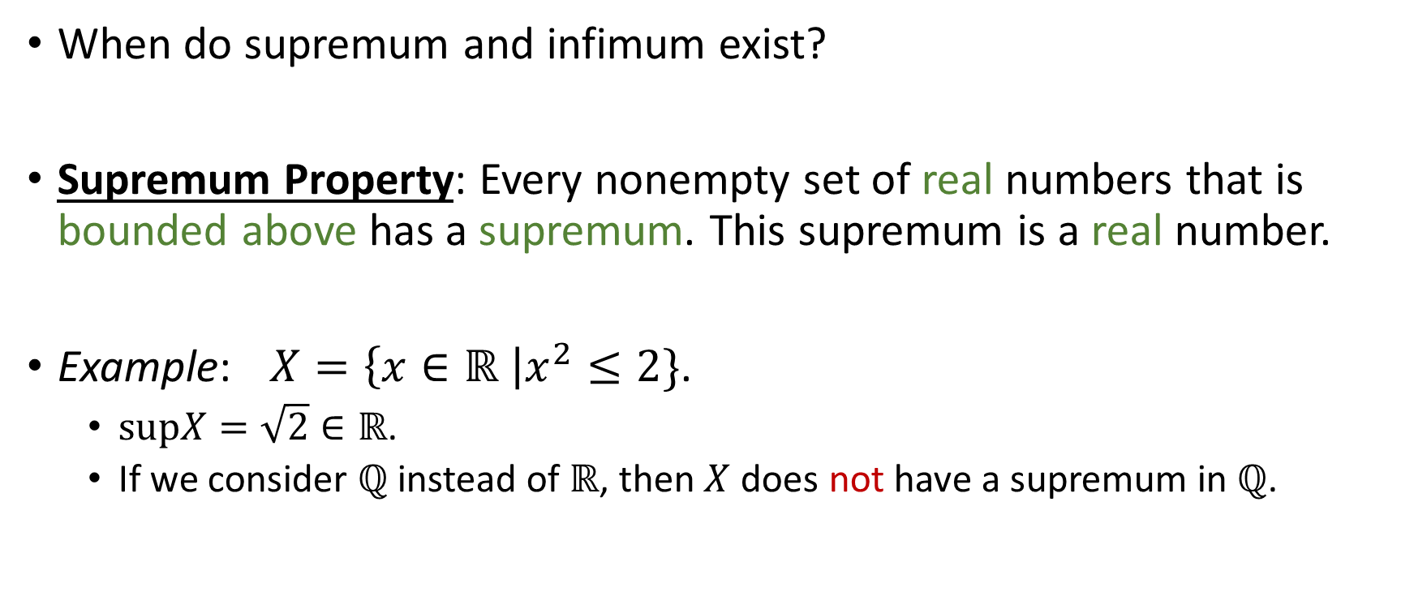
Supremum Property
When do supremum and infimum exist?
Supremum Property: Every nonempty set of real numbers that is bounded above has a supremum. This supremum is a real number.
Example: $X=\left\{x∈ℝ \right|x^{2}≤2\}$.
$supX=\sqrt{2}∈ℝ$.
If we consider $ℚ$ instead of $ℝ$, then $X$ does not have a supremum in $ℚ$.

Slide 6
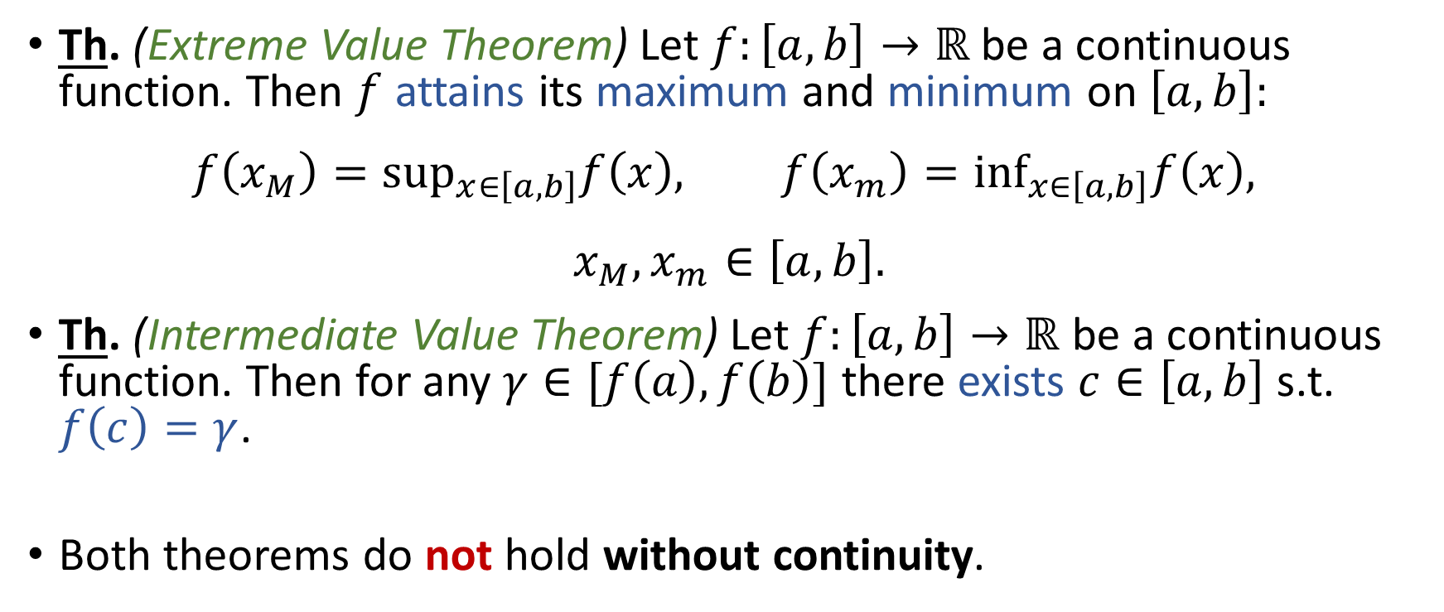
Properties of Continuous Real Functions
Th. (Extreme Value Theorem) Let $f:\left[a,b\right]→ℝ$ be a continuous function. Then $f$ attains its maximum and minimum on $\left[a,b\right]:$
$$f\left(x_{M}\right)=\sup_{x∈\left[a,b\right]}f\left(x\right), f\left(x_{m}\right)=\inf_{x∈\left[a,b\right]}f\left(x\right),$$
$$x_{M},x_{m}∈\left[a,b\right].$$
Th. (Intermediate Value Theorem) Let $f:\left[a,b\right]→ℝ$ be a continuous function. Then for any $γ∈[f\left(a\right),f\left(b\right)]$ there exists $c∈\left[a,b\right]$ s.t. $f\left(c\right)=γ$.
Both theorems do not hold without continuity.

Slide 7
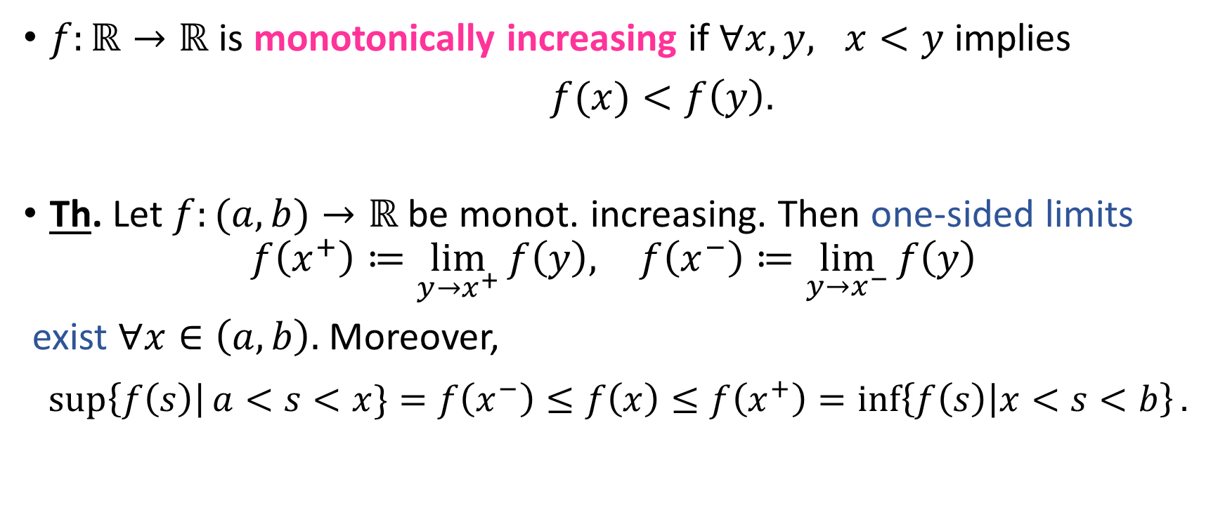
Monotonic Functions
$f:ℝ→ℝ$ is monotonically increasing if $∀x,y, x<y$ implies
$f(x)<f\left(y\right).$
Th. Let $f:(a,b)→ℝ$ be monot. increasing. Then one-sided limits
$$f\left(x^{+}\right)≔\lim_{y→x^{+}}{f\left(y\right), }f\left(x^{−}\right)≔\lim_{y→x^{−}}{f\left(y\right) }$$
exist $∀x∈\left(a,b\right).$ Moreover,
$$\sup\left\{f\left(s\right)\right|a<s<x\}=f\left(x^{−}\right)≤f\left(x\right)≤f\left(x^{+}\right)=\inf\left\{f\left(s\right) | x<s<b\right\}.$$

